Slide 1

WEB TECHNOLOGIES – LECTURE 13
UNIVERSITÀ DEGLI STUDI DI NAPOLI FEDERICO II
WEB FRAMEWORKS: EXPRESS
Luigi Libero Lucio Starace, PhD
luigiliberolucio.starace@unina.it https://docenti.unina.it/luigiliberolucio.starace https://luistar.github.io

Slide 2

PREVIOUSLY, ON WEB TECHNOLOGIES
We developed a few web apps using server-side programming
We implemented our To-do list app using CGI and Bash ( )
We implemented our To-do list app using PHP 8.2
We implemented our To-do list app using Node.js There were a few pain points
Lots of tedious stuff (e.g.: parse cookies, read and parse request bodies, …)
No out-of-the-box session management (except for PHP)
No out-of-the-box middleware support (e.g.: authentication)
No out-of-the-box templating

Slide 3
COMMON TASKS IN WEB DEVELOPMENT
Managing Routing
Rendering templates
Managing Web Sessions
Managing Authentication/Authorization
We do not want to re-invent the wheel in every project, right?

Slide 4
WEB FRAMEWORKS
A framework is a pre-defined set of software components, tools, and best practices that serve as a foundation for developing software
Web frameworks are specifically designed to simplify and streamline the development of web applications
They provide a (structured) way to build and organize web applications, reducing the need for developers to start from scratch and re-invent the wheel
Frameworks and Software Libraries are different things!

Slide 5
SOFTWARE LIBRARY
FRAMEWORK
Essentially a set of functions we can call to get some job done
Each call does some work and then returns control to the caller
User code (e.g.: our main method) is in control of the execution flow
Embody some abstract design, with more behaviour built-in
User-written code can be
plugged-in into the framework
The framework is in control of the execution flow and calls user code when appropriate

Slide 6















INVERSION OF CONTROL (IoC) PRINCIPLE
IoC is a defining feature of frameworks
The control flow is inversed from traditional imperative programming
The responsibility of managing the control flow is shifted from the developer to a framework
A.k.a. Hollywood’s Law: “Don't call us, we'll call you”.
Request
Response
Library A
Library B
Framework
1
6
Biagio Morgillo
2024-05-07 08:47:15
--------------------------------------------
Arriva una richiesta, il codice chiede alle librerie di prestare le loro informazioni e infine il codice genera una risposta. Stessa cosa succede coi framework
2
3
4
5
2
3
4
5
Request
1
Response
6
User Code
User Code
User Code

Slide 7
KEY COMPONENTS OF WEB FRAMEWORKS
Web frameworks typically include:
Core functionalities:
Routing; Request parsing; Input validation; Cookie management; Sessions…
Template Engine:
Helps in rendering dynamic content, separating code logic from the presentation layer.
ORM (Object-Relational Mapping) Mechanism:
Simplifies database interactions by allowing developers to work with objects
instead of SQL queries.

Slide 8


OPINIONATED FRAMEWORKS
Frameworks can be more or less opinionated
A (strongly) opinionated framework comes with a rigid set of pre-defined conventions, best practices, and decisions made by the framework's creators. It enforces a specific way of doing things, and leaves less wiggle room to devs.
Unopinionated frameworks do not enforce a specific way of doing things
Biagio Morgillo
2024-05-07 08:49:13
--------------------------------------------
Possono avere opinioni più o meno forti, perciò possono essere più o meno "opinionati".
Keep in mind, this framework has really strong opinions…
Artwork generated using DALL-E 3

Slide 9
OPINIONATED FRAMEWORKS
Pros
Ensure higher levels of consistency across different projects
Can speed up development, reducing decision fatigue
Cons
May have a steeper learning curve
May not be flexible enough for a certain project

Slide 10

















WEB FRAMEWORKS (SERVER-SIDE)
Many web frameworks to choose from (e.g.: see Wikipedia)
JYNX
One of the above is not a real framework, but a Pokemon. Can you tell which one?

Slide 11
EXPRESS
Fast, unopinionated, minimalist web framework for Node.js

Slide 12
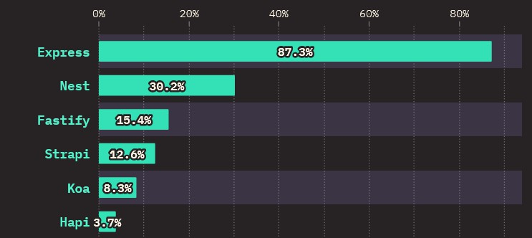
THE EXPRESS FRAMEWORK
In the web technologies course, we’ll see Express as an example
Fast, unopinionated, minimalist web framework for Node.js
By far, the most popular Node.js backend framework
State of JavaScript 2022 Report. Source here.

Slide 13

HELLO EXPRESS
@luigi ➜ D/O/T/W/2/e/express-hello-world$ npm install express
import express from "express";
const app = express(); // creates an express application
const PORT = 3000;
app.get('/', (req, res) => { res.send('Hello World!')
});
app.listen(PORT);
Biagio Morgillo
2024-05-07 08:55:40
--------------------------------------------
req = request res = response

Slide 14
EXPRESS: ROUTING
Routing refers to the way the framework determines how to handle a request to a given endpoint
A route is defined using appropriate methods on the app object
Typically using statements of the form
app.<METHOD>(<PATH>, callback)
Where <METHOD> and <PATH> identify an endpoint, and callback is a function to execute to handle requests to that endpoint
app.get("/hello", (req, res) => {
res.send("Hello");
});
app.post("/hello", (req, res) => {
res.send("Hello Post");
});

Slide 15
EXPRESS: ROUTE PATHS
Route paths can be strings, string patterns, or full regular expressions
In case of multiple matches, the first matched route applies
app.get("/webtech", (req, res) => {
res.send("Web Technologies!");
});
//matches /webtech, /web-tech, /web-technologies, /webtechnologies, etc...
app.get("/web(-)?tech*", (req, res) => {
res.send("Web Technologies Pattern!");
});
//matches /webtech, /wirelesstech, /wtech, /whatever-tech, etc... app.get(/^\/w.*tech$/, (req, res) => {
res.send("Web Technologies Regex!");
});

Slide 16

EXPRESS: ROUTE PARAMETERS
Express routes can also capture named URL segments called parameters, declared in the PATH by using «:paramName»
The captured parameters are made available in the req.params obj.
//if a get request is made to /student/42/exams/TecWeb app.get("/student/:student_id/exams/:exam_name", (req, res) => {
res.send(req.params); //{"student_id":"42","exam_name":"TecWeb"}
});
//finer control over admissible param values can be defined using regex in parentheses. The below route requires :student_id to be a series of digits. It matches /student/42/exams/TecWeb, but not /student/bob/exams/TecWeb. app.get("/student/:student_id([0-9]+)/exams/:exam_name", (req, res) => {
res.send(req.params); //{"student_id":"42","exam_name":"TecWeb"}
});
Biagio Morgillo
2024-05-07 09:03:13
--------------------------------------------
I parametri dichiarati in questo path sono lo student_id ed exam_name, infatti sono preceduti da : e dal nome del parametro

Slide 17

EXPRESS: MULTIPLE ROUTE HANDLERS
It is also possible to specify multiple handler functions for a route
These functions behave like middleware (we’ll see soon enough!)
next is a callback to the next handler function to run
let | f1 | = | function(req, | res, | next) | {console.log("f1"); | next();}
let | f2 | = | function(req, | res, | next) | {console.log("f2"); | next();}
let | f3 | = | function(req, | res, | next) | {console.log("f3"); | next();}
app.get("/handlers", [f1, f2, f3], (req, res) => { res.send("Done with all handlers");
})

Slide 18
EXPRESS: WORKING WITH ROUTES
We can create chainable routes using app.route()
This way, the path is specified in a single location (less redundancy), and method-specific handlers are chained.
app.route('/book')
.get((req, res) => { res.send('Get a random book')
})
.post((req, res) => { res.send('Add a book')
})
.delete((req, res) => { res.send('Delete a book')
});

Slide 19
EXPRESS: MODULAR ROUTERS
We can also create a modular router, which can be loaded as needed
//router.js
import express from "express";
export const router = express.Router();
router.get("/echo/:value", (req, res) => { res.send(req.params.value);
});
import { router as echoRouter } from "./router.js"; const app = express();
//other routes can be defined here as done earlier...
app.use("/custom", echoRouter); //load echoRouter (optionally in a certain path)
//requests to /custom/echo/:value will be handled by the router app.listen(3000);

Slide 20
EXPRESS: RESPONSE METHODS
Appropriate methods on the response object (res) should be called to send a response to the client, or the request will remain hanging.
Method | Description
res.download() | Prompt a file to be downloaded.
res.end() | End the response process.
res.json() | Send a JSON response.
res.jsonp() | Send a JSON response with JSONP support.
res.redirect() | Redirect a request.
res.render() | Render a view template.
res.send() | Send a response of various types.
res.sendFile() | Send a file as an octet stream.
res.sendStatus() | Set the response status code and send its string representation as the response body.

Slide 21
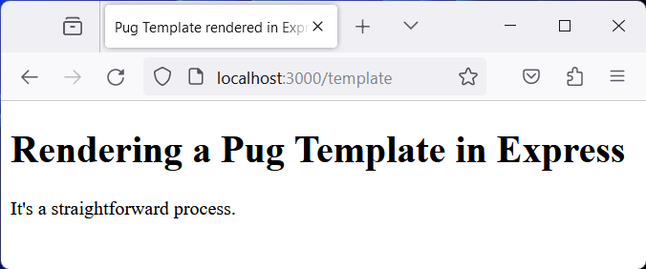
EXPRESS: RENDERING A TEMPLATE
const app = express();
app.set("view engine", "pug");
app.get('/template', (req, res) => { res.render("template");
});
app.listen(3000);
//- file: /views/template.pug doctype html
html
head
title Pug Template rendered in Express
body
h1 Rendering a Pug Template in Express p It's a straightforward process.

Slide 22
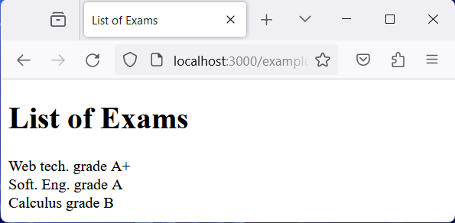
EXPRESS: RENDERING A TEMPLATE
Moreover, data set in the res.locals object is available to all views
Data set in the res.locals is available to views rendering res
app.get("/example", (req, res) => { res.locals.items = [
{name: "Web tech.", grade: "A+"},
{name: "Soft. Eng.", grade: "A"},
{name: "Calculus", grade: "B"},
]
res.render("example");
});
//- file: /views/example.pug doctype html
html
head
title List of Exams body
h1 List of Exams each exam in items
li #{exam.name} grade #{exam.grade}

Slide 23
EXPRESS: THE REQUEST-RESPONSE CYCLE
The Request-Response cycle is the core of the Express framework
Express App
Create a request and response object
Perform a sequence of one or more computation steps to process the request
parse request body
parse cookies
estabilish a session
…
Prepare and send the response
HTTP
Request
HTTP
Response

Slide 24
EXPRESS: THE REQUEST-RESPONSE CYCLE
The Request-Response cycle is the core of the Express framework
Express App
Matched Route
Middleware stack
Middleware
(e.g.: log request)
Middleware
(e.g.: parse body)
Middleware
(e.g.: CSRF
check)
Middleware
HTTP
Request
HTTP
Response

Slide 25
MIDDLEWARES
In Express, middlewares are functions that can manipulate the current request and response object or execute any arbitrary code
They’re called that because they are executed in between receiving a request and sending back its response
Middlewares are executed in the same order they are declared in
They are functions that take as input arguments:
req (the HTTP request object) and res (the HTTP response object)
next (a callback function that calls the next middleware in the stack)

Slide 26
OUR FIRST EXPRESS MIDDLEWARE
// defined in some module
export function logger(req, res, next) {
console.log("LOGGER HAS BEEN CALLED!");
next();
}
// index.js file starting the express app
app.use(logger); // mounts the middleware function "logger" in the "/" path
app.get('/', (req, res) => { res.send('Hello World!')
});
app.listen(PORT);
HTTP
Req
logger
res.send("Hello World!")
HTTP
Res

Slide 27
OUR FIRST EXPRESS MIDDLEWARE
// defined in some module
export function addTimestamp(req, res, next){
req.timestamp = new Date(); next();
}
// index.js file starting the express app
app.use(addTimestamp);
app.use(logger); // mounts the middleware function "logger" in the "/" path
app.get('/', (req, res) => {
res.send(`Request received at ${req.timestamp}`)
});
app.listen(PORT);
HTTP
Req
addTimestamp
logger
res.send("...")
HTTP
Res

Slide 28
EXPRESS: THE REQUEST-RESPONSE CYCLE
Express App
Matched Route
Middleware stack
Middleware (parse body)
Middleware (check auth)
Route
Handler
HTTP
Request
Middleware
next()
next()
next()
(logging)
res.send()
res.send()
res.send()
res.render()
HTTP
Response

Slide 29
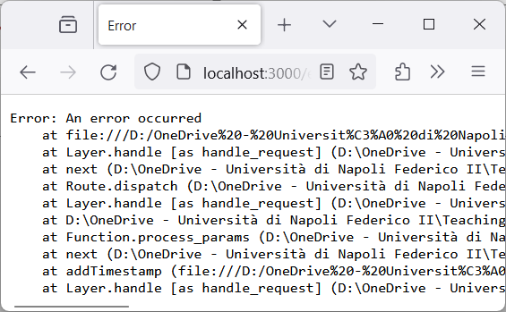
HANDLING ERRORS
It’s important to make sure that any error occurring when processing middlewares or routes is properly handled by Express.
If an error is thrown during synchronous code execution it will be automatically caught by the Express default error handler
app.get("/error", (req, res) => {
throw new Error("An error occurred");
});

Slide 30
HANDLING ERRORS
Errors returned from asynchronous functions invoked by route handlers and middlewares must be passed to the next() function
app.get('/readfile', (req, res, next) => {
fs.readFile('/file-does-not-exist', (err, data) => {
if (err) {
next(err) // Pass errors to Express.
} else { res.send(data)
}
})
});

Slide 31
HANDLING ERRORS (IN EXPRESS 5)
Starting from Express 5 (currently still in beta), route handlers and middlewares that return a promise will automatically call next(value) when they reject or throw an error.
So, we won’t need to do it explicitly
app.get('/user/:id', async (req, res, next) => { const user = await getUserById(req.params.id) res.send(user)
})

Slide 32
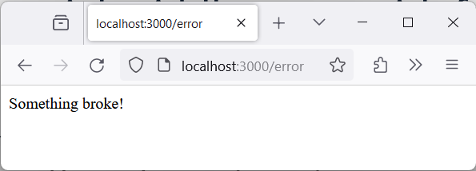
ERROR HANDLERS
Express includes a default error handler. The default handler prints the entire stack trace only when in development mode.
We can define custom error handlers as well
They are special middlewares with four input parameters
app.use((err, req, res, next) => { console.error(err.stack); res.status(500).send('Something broke!');
});

Slide 33
USEFUL MIDDLEWARE

Slide 34
EXPRESS.STATIC
express.static is a built-in middleware designed to serve static files
// Register the built-in express.static middleware to serve static files.
// All files in the /public directory will be served as static files. app.use(express.static("public"));
Uses req.url to determine whether a request matches the specified root directory (e.g.: public)

Slide 35
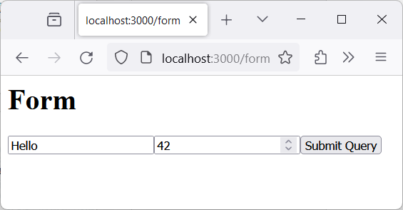
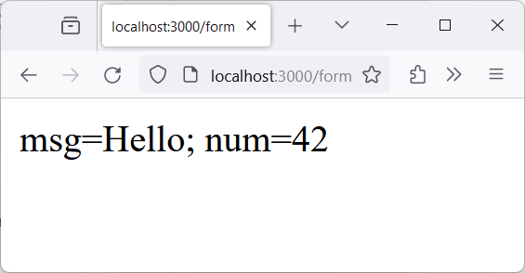
EXPRESS.URLENCODED
express.urlencoded is a built-in middleware that parses the body of incoming requests with urlencoded payloads
// Parses url-encoded body (e.g.: those in requests submitted via forms)
// and makes the parameters available in the req.body object.
app.use(express.urlencoded({extended: false}))
app.get("/form", (req, res) => { res.render("form"); });
app.post("/form", (req, res) => {
res.send(`msg=${req.body.msg}; num=${req.body.num}`);
});
h1 Form
form(action="/form" method="POST") input(type="text" name="msg") input(type="number" name="num") input(type="submit")

Slide 36
EXPRESS.JSON
express.json is a built-in middleware. Behaves similarly to express.urlencoded, but is designed to parse JSON request bodies.
app.use(express.json());
app.post("/json", (req, res) => { res.send(`exam=${req.body.exam}; grade=${req.body.grade}`);
})
POST http://localhost:3000/json HTTP/1.1
Content-Type: application/json
{
"exam": "Web Technologies", "grade": "A+"
}
HTTP/1.1 200 OK
X-Powered-By: Express
Content-Type: text/html; charset=utf-8 Content-Length: 31
exam=Web Technologies; grade=A+

Slide 37
EXPRESS-SESSION
express-session is a middleware available through npm
It simplifies the management of a server-stored session
Session data is stored on the server, session id is stored in a cookie
Notice: the default server-side storage is not production ready! For production, you should setup a dedicated session store (e.g.: memcached or redis-based).

Slide 38
EXPRESS-SESSION: EXAMPLE
app.use(session({
secret: "s3cr37", saveUninitialized: false, resave: false
}));
app.get("/session-counter", (req, res) => { if(! req.session?.count) {
req.session.count = 1;
res.send("It's the first time you visit this page.");
} else {
req.session.count = req.session.count + 1;
res.send(`You visited this page ${req.session.count} times.`);
}
});

Slide 39
COOKIE-PARSER
cookie-parser is a middleware available through npm
It parses the Cookie header in incoming requests, and populates req.cookies with an object whose properties are the cookie names
app.use(cookieParser());
app.get("/cookie-counter", (req, res) => { if(! req.cookies?.count){
res.cookie("count", 1, {maxAge: 10*60*1000}); res.send("It's the first time you visit this page.");
} else {
res.cookie("count", parseInt(req.cookies.count) + 1, {maxAge: 10*60*1000}); res.send(`You visited this page ${parseInt(req.cookies.count) + 1} times.`);
}
});

Slide 40
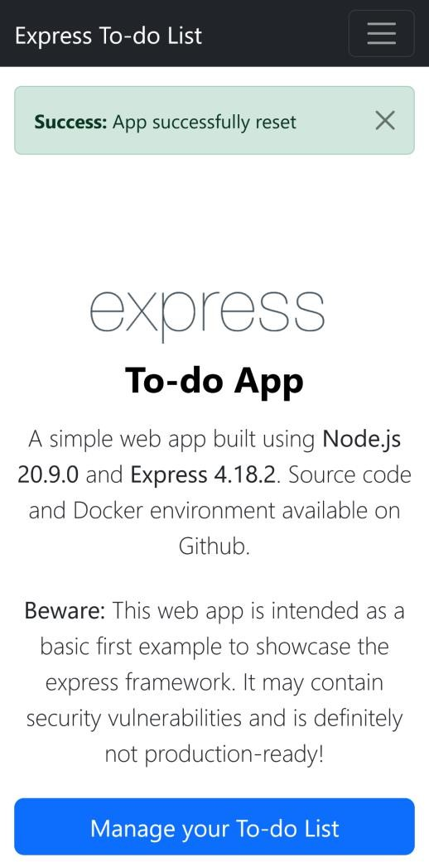
FLASH MESSAGES
Often, in web applications, users are redirected after performing some action (e.g.: redirect to homepage after deleting some data).
It’s a good rule of thumb to provide some feedback to users in these cases, so they know whether the operation they performed was successful or not.
The «difficult» part is that, after redirecting, a whole new request-response cycle starts. How to keep track of the fact that we need to show some flash message?

Slide 41
FLASH MESSAGES
Different variation of the same old problem of HTTP being stateless
We can solve this in the same ways we did before: cookies, sessions…
Some middlewares can be quite useful at that!
One such example is connect-flash, available on npm
import flash from "connect-flash"; //simple middleware for flash messages
app.use(flash()); //register the middleware

Slide 42
FLASH MESSAGES: EXAMPLE
app.use(flash());
app.get("/redirect", (req, res) => {
req.flash("info", "You have been redirected."); // Saves flash messages req.flash("info", "This is a demo to demonstrate flash messages."); req.flash("success", "Everything was fine.");
req.flash("error", "But we also have an error message.");
res.redirect("/showflash");
})
app.get("/showflash", (req, res) => {
After being consumed, flash messages are deleted
let infos = req.flash("info"); // Consumes flash messages with the given key
let successes = req.flash("success");
let errors = req.flash("error");
res.render("flash", {infos: infos, successes: successes, errors: errors});
})

Slide 43
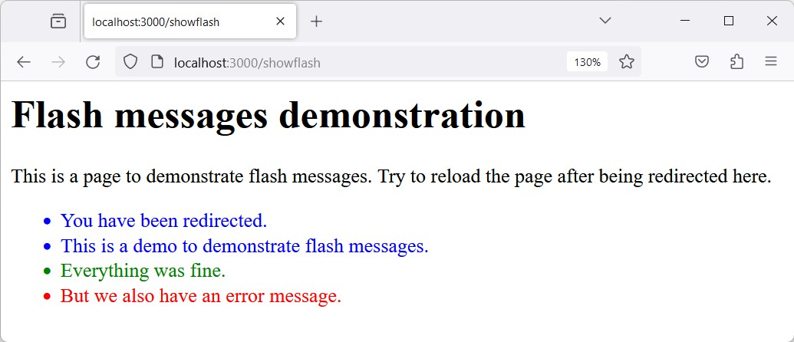

FLASH MESSAGES: EXAMPLE
ul
each info in infos
li(style="color: blue") #{info} each success in successes
li(style="color: green") #{success} each error in errors
li(style="color: red") #{error}

Slide 44
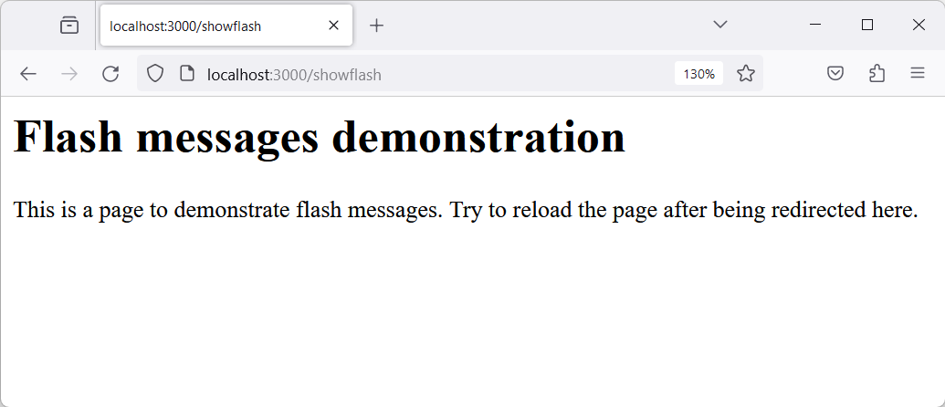
FLASH MESSAGES: EXAMPLE
If we reload the /showflash page (or visit it directly without being redirected by the /redirect page, no flash message will be stored in the current session, and we get:

Slide 45
SOURCE CODE AVAILABILITY
The code in these slides is available in the Course Materials on Teams
You should check the code out, run (and debug) the web app

Slide 46
REFERENCES
Express web framework (Node.js/JavaScript)
MDN web docs
https://developer.mozilla.org/en-US/docs/Learn/Server-side/Express_Nodejs
Inversion of Control
By Martin Fowler
https://martinfowler.com/bliki/InversionOfControl.html
Express Guide
Official Express website https://expressjs.com/en/guide/routing.html https://expressjs.com/en/guide/writing-middleware.html https://expressjs.com/en/guide/using-middleware.html https://expressjs.com/en/guide/using-template-engines.html https://expressjs.com/en/guide/error-handling.html

